Slide 1

Tidy Data I

Slide 2
Intro to Tidy Data
Read Chapter 9
Functions From tidyr Package
gather()
spread()
separate()
unite()
complete()
fill()
>library(tidyr)

Slide 3
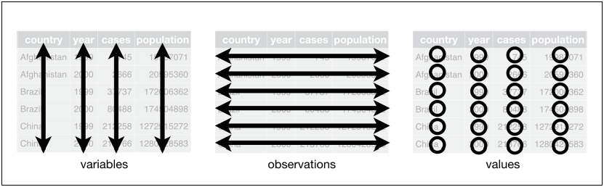
Tidy Data Defined
For Tidy Data:
Each Variable Must Have Its Own Column
Each Observation Must Have Its Own Row
Each Value Must Have Its Own Cell

Slide 4
Problem
Most Data is Not Tidy
Reason: Data Collectors Often Don’t Know How Data Should Be Recorded Since They Don’t Analyze the Data
Common Problems
A Variable Spread Across Multiple Columns
A Observation is Spread Across Multiple Rows
“Until we can fix people we must fix the data”
– Mahatma Mario

Slide 5
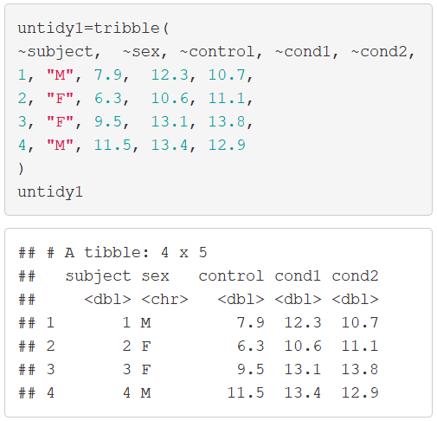
Untidy Data Example 1

Slide 6
Gathering
Multiple Treatment Data
Variables “Control”, “Cond1”, and “Cond2” are Measuring the Same Thing Under Different Treatments
The Name of the Variable Whose Values Form the Column Names Can Be Called “Treatment”
The Name of the Variable Whose Values are Spread Over the Cells Can Be Called “Outcome”

Slide 7
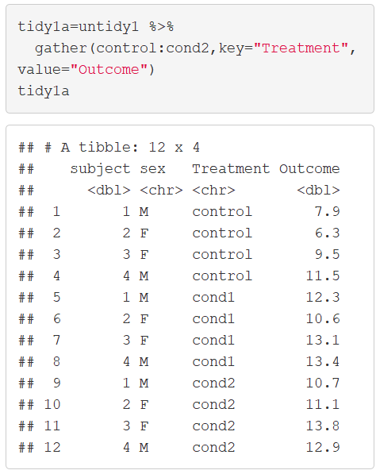
Gathering

Slide 8
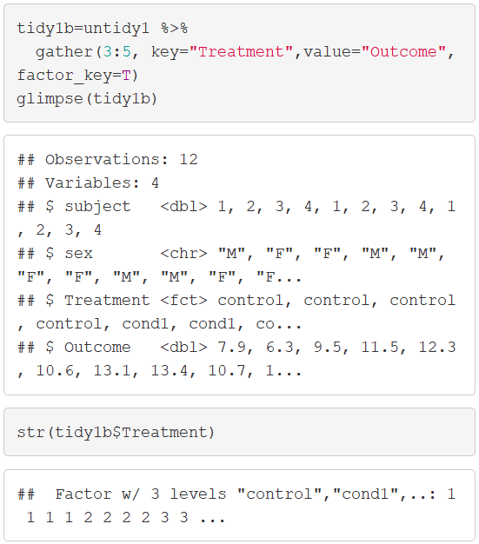
Gathering

Slide 9
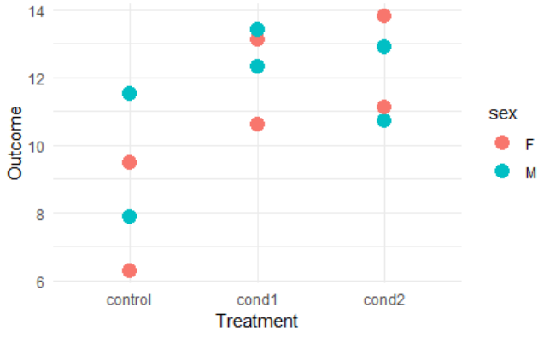
Gathering
Why Do This Nonsense?

Slide 10
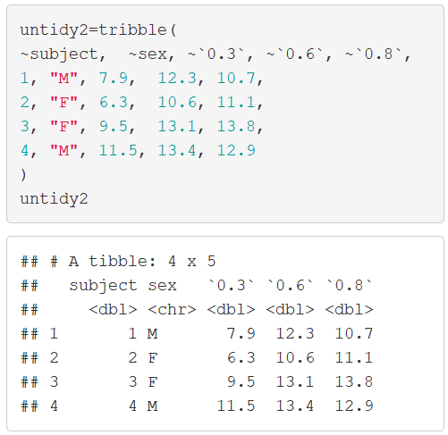
Untidy Data Example 2

Slide 11
Gathering
Repeated Measures Data
Variables “0.3”, “0.6”, and “0.8” are Measuring the Same Thing Under Different Drug Strengths
The Name of the Variable Whose Values Form the Column Names Can Be Called “Dosage”
The Name of the Variable Whose Values are Spread Over the Cells Can Be Called “Outcome”

Slide 12
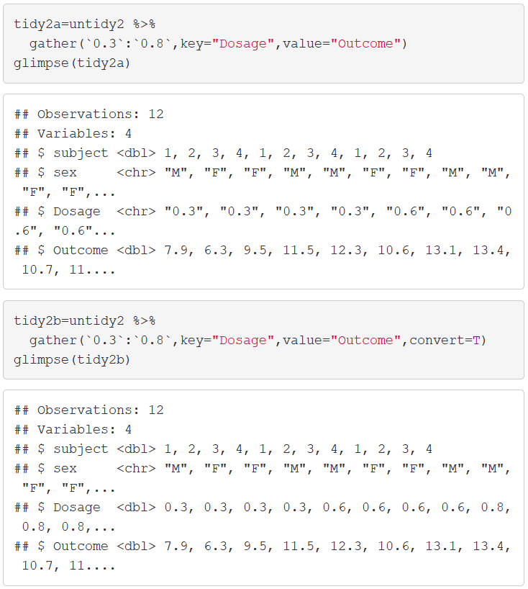
Gathering

Slide 13
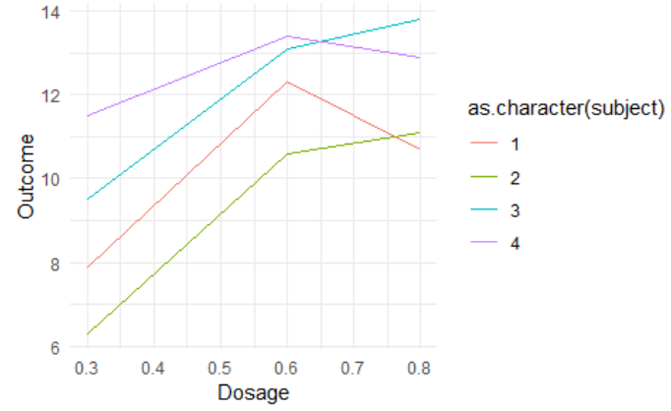
Gathering
Why Do This Nonsense?

Slide 14
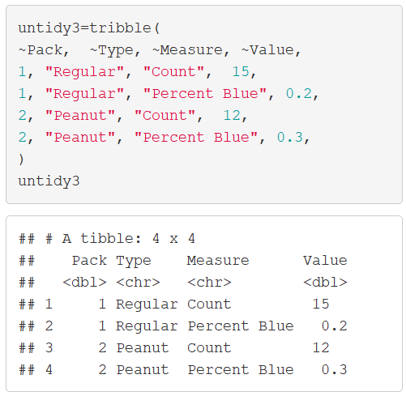
Untidy Data Example 3

Slide 15
Spreading
Less Common
Column “Measures” Contains Variable Names
Column “Value” Contains the Output of the Different Variables
Notice Values are of Different Units (Count vs Percentage)
Spreading Does the Opposite of Gathering

Slide 16
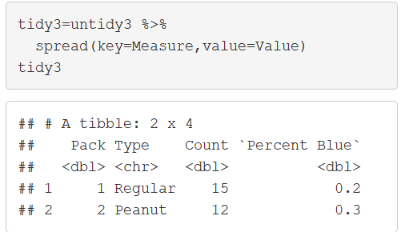
Spreading

Slide 17
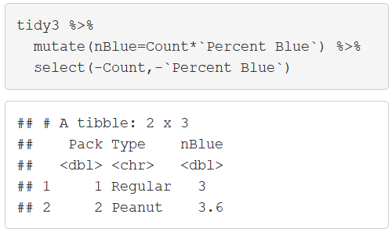
Spreading
Why Do This Nonsense?

Slide 18
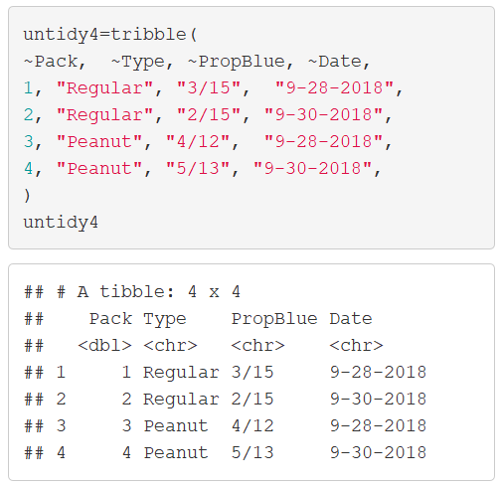
Untidy Data Example 4

Slide 19
Separating
Very Uncommon
The Variable “PropBlue” Contains Two Numeric Variables
The Variable “Date” Contains Three Numeric Variables
We Must Separate Both of These Variables Into Multiple Columns

Slide 20
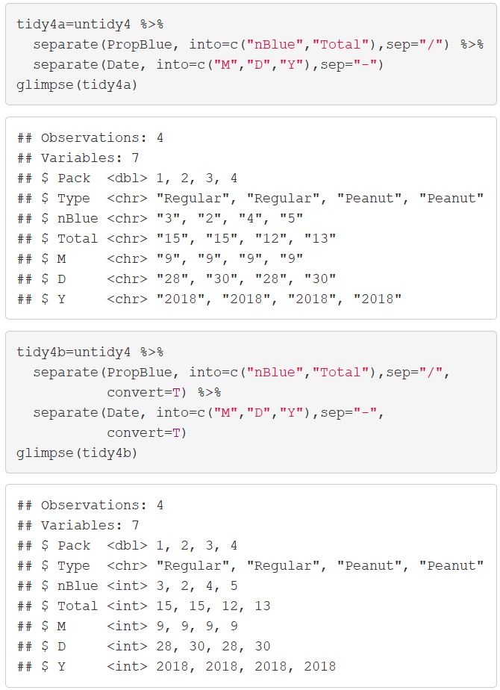
Separating

Slide 21
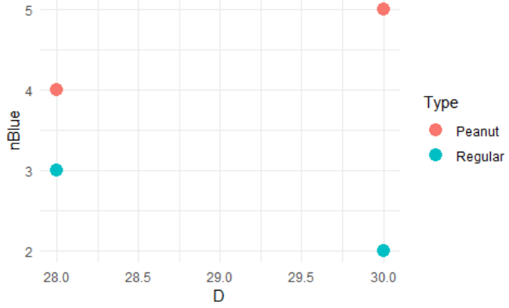
Separating
Why Do This Nonsense?
“I have no idea”
Maybe…

Slide 22
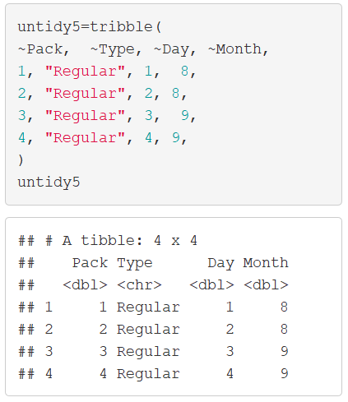
Untidy Data Example 5

Slide 23
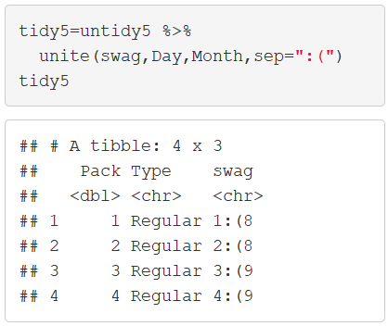
Uniting
Absolutely Silly
Uniting Does the Opposite of Separating

Slide 24
Missing Values
Two Ways
Explicitly: Defined to Be Missing Using NA
Implicitly: Absent From Data
There is not a Uniform Way to Handle Either of These Problems
Rule: Either Convert All Explicitly Missing to Implicitly Missing or Convert All Implicitly Missing to Explicitly Missing

Slide 25
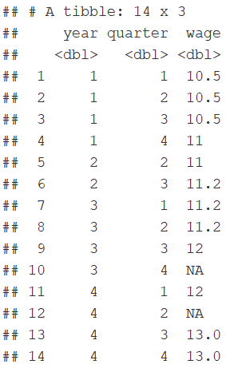
Missing Example

Slide 26
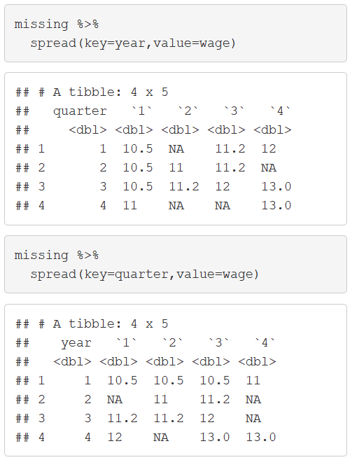
Missing Values
Notice:

Slide 27
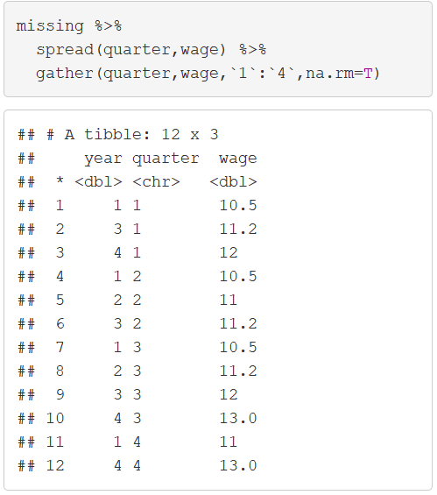
Missing Values
Explicit to Implicit

Slide 28
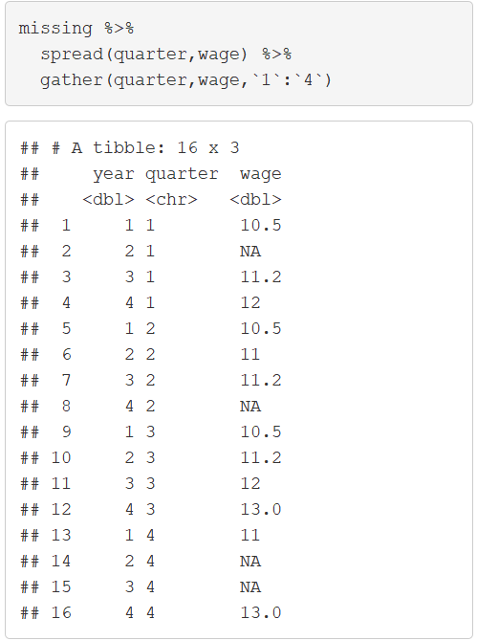
Missing Values
Implicit to Explicit

Slide 29
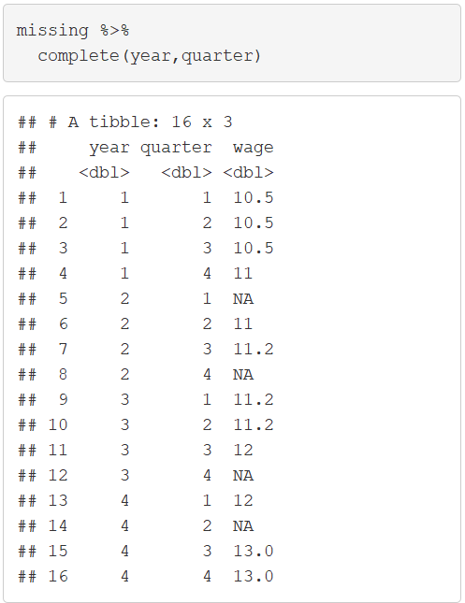
Missing Values
Complete Function

Slide 30
Closing
Disperse and Make Reasonable Decisions

